Slide 1


Rohit Sayeeganesh
1/18/2023

Slide 2

Outline
Executive Summary
Introduction
Methodology
Results
Conclusion
Appendix

Slide 3

Executive Summary
Over the synopsis of the labs from the SpaceX API, some methodologies that were used included Data Collection and Integration, Machine Learning Algorithms, Predictive Analytics, Data Visualization, and many more. Throughout the studying of these labs, we found many different launch sites that had either successes or fails in launch sequences, locations on Folium Maps on launch sites, calculations depicting the likelihood of success in launches, and many more.

Slide 4

Introduction
From this project, we will be working with SpaceX launch data that is gathered from the SpaceX Rest API. This API gives us data about launches, including information about the rocket used, payload delivered, launch specifications, landing specifications, and landing outcomes.
Our essential goal is to use this data to essentially predict whether SpaceX will attempt to land a rocket or not.

Slide 5

Section 1

Slide 6
Methodology
The data for this project was collected through a combination of sources, including official records from the SpaceX API, locational markers of launch sites, etc. The information gathered includes details about each launch, including booster version, launch date, flight number, payload mass, orbits, and outcomes. There are many more but that is a basic synopsis.
The data underwent a data wrangling process to ensure its quality for analysis. I first handled missing values, then I tried eliminating duplicate records so that the data was as good as it can be.
As part of the exploratory data analysis (EDA), I used both visualization techniques and SQL queries to essentially gain a high-level overview of the data distribution, trends, and relationships between variables. This is where I created charts to try and “visualize” the distributions.
As part of interactive visual analytics, I employed two tools: Folium and Plotly Dash. Folium, in essence, is used to create maps to visualize locational data, whereas Plotly Dash is used to build interactive dashboards, enabling users to perform real-time visual analytics on a dataset. The combination of both provides a comprehensive solution for both geospatial and non-spatial visual analytics.
In our predictive analysis, I employed classification models to make predictions based on our dataset. Some things that were included is logistic regression, Support Vector Machine, K Nearest Neighbors, etc.

Slide 7
Data Collection – SpaceX API
The flowchart is to the right of this specific text bubble, which covers a basic synopsis of the data collection process using SpaceX REST calls and key phrases from the API.
https://github.com/RohitCodes22/Capstone-Repository-Final
Start
Initialize API Connection
Specify API Endpoint and Parameters
Make REST Call
Receive API Response
Handle Response
Data Processing
Store Data
Iterative Process
End

Slide 8
Data Collection - Scraping
The flowchart is to the right of this specific text bubble, which covers a basic synopsis of the data collection scraping process.
https://github.com/RohitCodes22/Capstone-Repository-Final
Start
Specify Target Website
Identify Data Elements
Initialize Web Scraping Tools
Send HTTP Request
Receive HTML Response
Parse HTML
Data Processing
Store Data
Iterative Process
Handle Pagination
Error Handling
End

Slide 9
Data Wrangling
The data was processed through collection, assessments, handling anomalies and missing data, as well as transforming the data. We also formatted the data in a way that is suitable for the chosen analysis tools and modeling approaches.
https://github.com/RohitCodes22/Capstone-Repository-Final
Start: Data Collection
Initial Assessment
Handle Missing Data
Data Cleaning
Feature Engineering
Data Transformation
Handle Categorical Data
Quality Checks
Merge or Join Data
Final Data Format
Documentation
Iterative Process
End

Slide 10

EDA with Data Visualization
Through Data Visualization tactics, we plotted charts such as cat plots, scatterplots, bar graphs, and line plots to depict the relationship between launch site and success rate of launches, as well as relationships between orbits and success rates, and many more.
https://github.com/RohitCodes22/Capstone-Repository-Final

Slide 11
EDA with SQL
Here are the SQL tasks I did:
Task 1: Executed SQL query to retrieve distinct launch sites.
Task 2: Executed SQL query to retrieve records where the launch site starts with ‘CCA’.
Task 3: Executed SQL query to calculate the total payload mass for NASA (CRS) missions.
Task 4: Executed SQL query to calculate the average payload mass for F9 v1.1 boosters.
Task 5: Executed SQL query to find minimum date with a successful landing on the ground pad.
Task 6: Executed SQL query to retrieve distinct booster versions meeting the criteria.
Task 7: Executed SQL query to count the occurrences of different mission outcomes.
Task 8: Executed SQL query to find booster versions with the maximum payload mass.
Task 9: Executed SQL query to retrieve records with failure landing outcomes in drone ship for each month in 2015.
Task 10: Executed SQL query to rank the count of landing outcomes in descending order for a specified date range.
https://github.com/RohitCodes22/Capstone-Repository-Final

Slide 12

Build an Interactive Map with Folium
In this folium map, I created and added the following objects:
Number 1: Launch Site Circles -> Circles were added to essentially represent the launch sites
Number 2: Launch Site Markers -> These markers were added to label each launch site on the map.
Number 3: Marker Cluster -> These clusters were created to handle cases as where launches shared locations.
Number 4: Launch Outcome Markers -> These markers were added based on the outcome (success/failure).
Number 5: Distance Markers -> These markers were added to indicate the distance from the launch to highways, etc.
Number 6: Polyline -> This line was drawn between the launch site and the closest destinations from it.
https://github.com/RohitCodes22/Capstone-Repository-Final

Slide 13
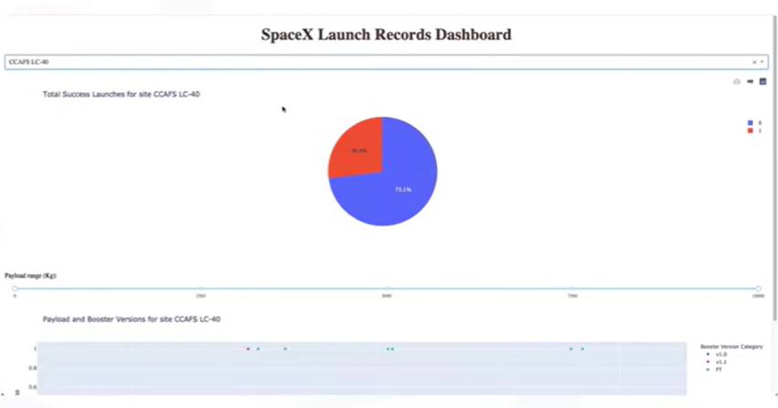
Build a Dashboard with Plotly Dash
Here are some of the plots/graphs and interactions I included in my Plotly Dashboard:
Number 1: Launch Site Dropdown -> Allows users to select data for specific launch sites
Number 2: Success Pie Chart -> Shows the distribution of successful and failed launches
Number 3: Payload Range Slider -> Enables users to filter launches based on mass range
Number 4: Success-Payload Scatter Chart -> Correlation between mass and launch success
Number 5: Callback Functions -> Updates the pie chart
Number 6: Payload Slider Interaction -> Updates the scatter chart based on range
https://github.com/RohitCodes22/Capstone-Repository-Final

Slide 14
Predictive Analysis (Classification)
We in essence used multiple analysis techniques to find the best model, which will be explained better in future slides.
https://github.com/RohitCodes22/Capstone-Repository-Final
Start
Exploratory Data Analysis
Data Preprocessing
Feature Engineering
Model Selection
Training
Evaluation
Model Comparison
Improvement and Final select
Results
End

Slide 15

Section 2

Slide 16
GitHub Link for all of these diagrams and queries
https://github.com/RohitCodes22/Capstone-Repository-Final

Slide 17
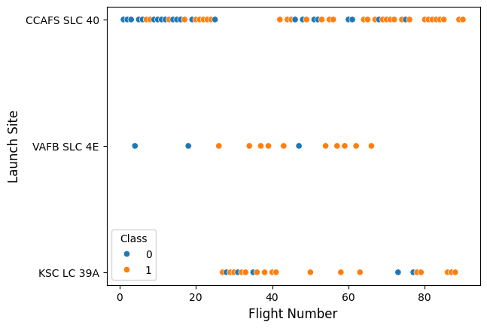
Flight Number vs. Launch Site

Slide 18
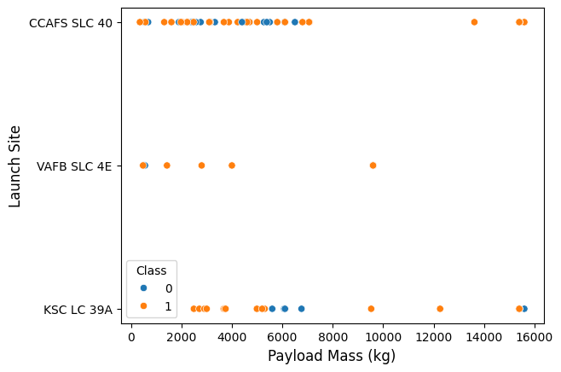
Payload vs. Launch Site

Slide 19
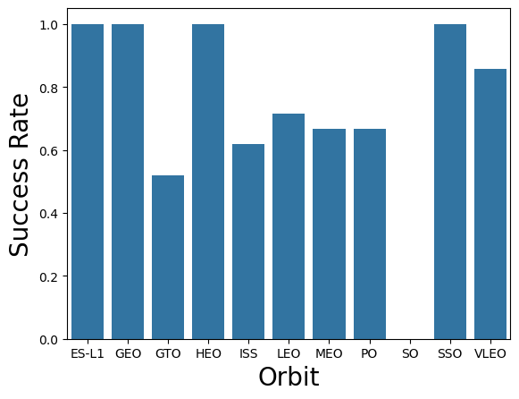
Success Rate vs. Orbit Type

Slide 20
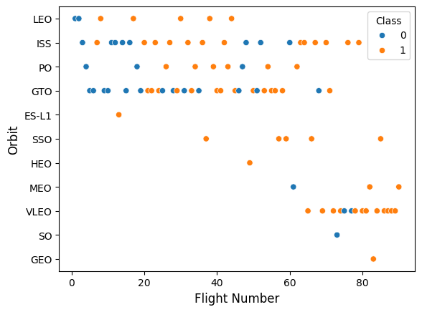
Flight Number vs. Orbit Type

Slide 21
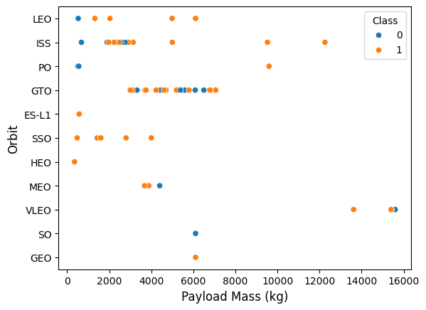
Payload vs. Orbit Type

Slide 22
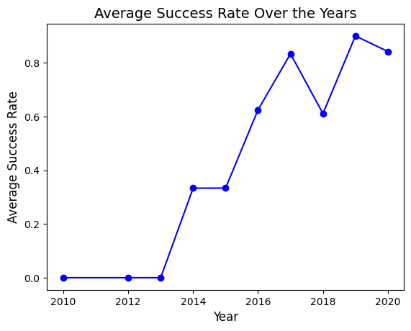
Launch Success Yearly Trend

Slide 23
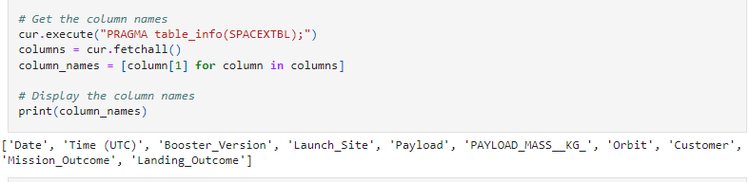
All Launch Site Names

Slide 24
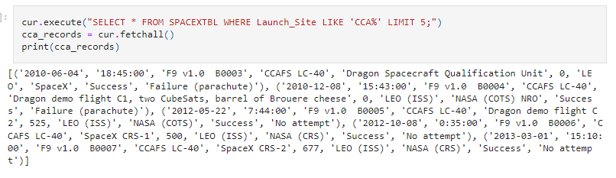
Launch Site Names Begin with 'CCA'

Slide 25
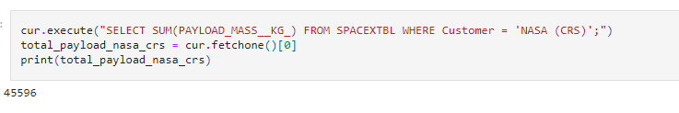
Total Payload Mass

Slide 26
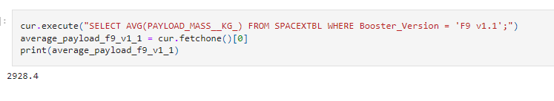
Average Payload Mass by F9 v1.1

Slide 27
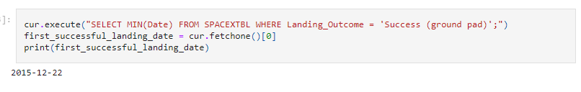
First Successful Ground Landing Date

Slide 28
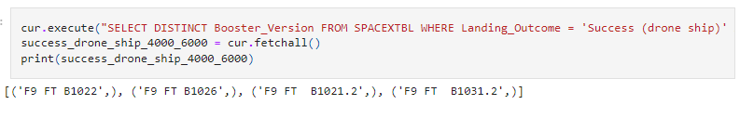
Successful Drone Ship Landing with Payload between 4000 and 6000

Slide 29
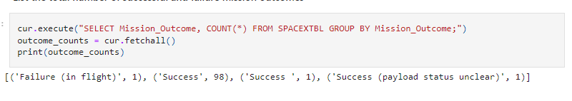
Total Number of Successful and Failure Mission Outcomes

Slide 30
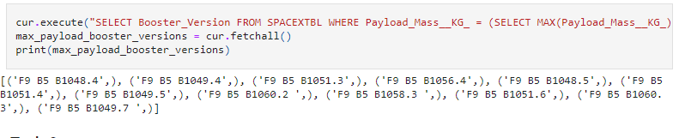
Boosters Carried Maximum Payload

Slide 31
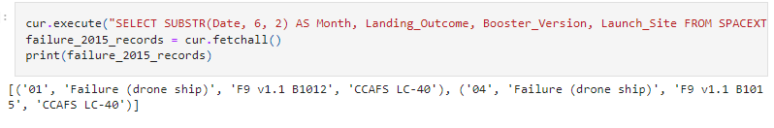
2015 Launch Records

Slide 32
Rank Landing Outcomes Between 2010-06-04 and 2017-03-20

Slide 33

Section 3

Slide 34
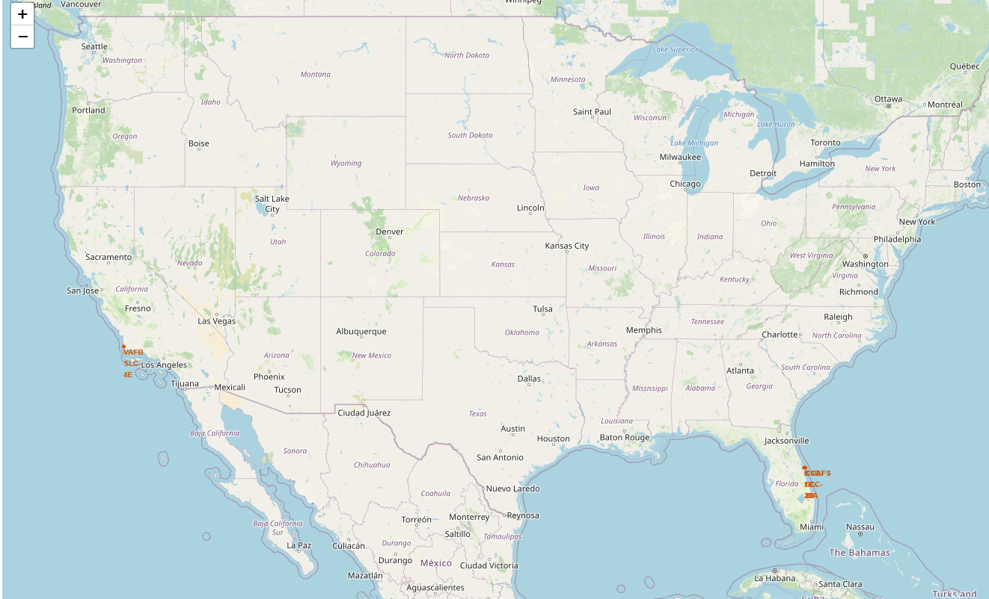
The Launch Sites on the Map
Using Folium and python programming, we were able to retrieve the launch sites on a map of the United States. As per what we see here, we see a couple of launch sites in California, and a couple of launch sites in Florida.

Slide 35
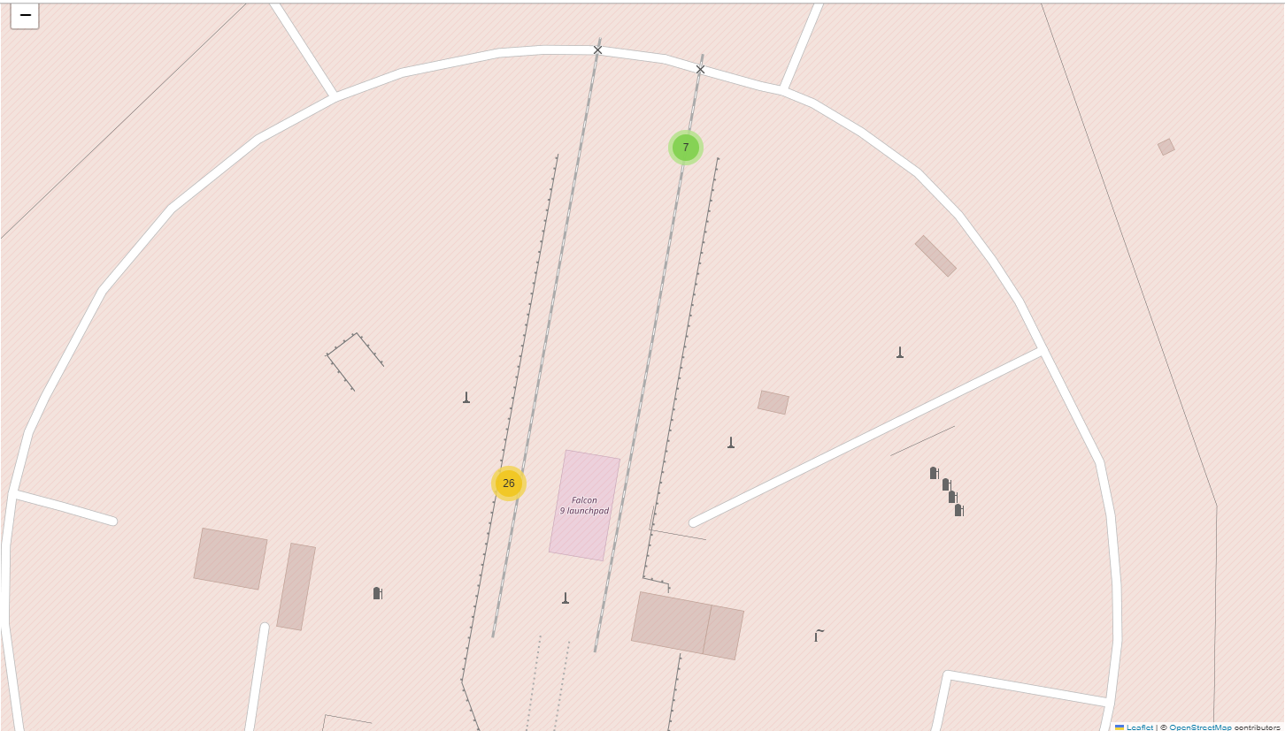
A Map With Color-Labeled Points
Here is a close-up map in Florida of some launches that happened from SpaceX launch sites. The green represents successes, and the yellow represents failures.

Slide 36

Section 5

Slide 37











Classification Accuracy
Given all of the options, being Logistic Regression, Support Vector Machine (SVM), Decision Tree, and k-Nearest Neighbors (kNN), the best performing method was in fact Logistic Regression.
https://github.com/RohitCodes22/Capstone-Repository-Final

Slide 38
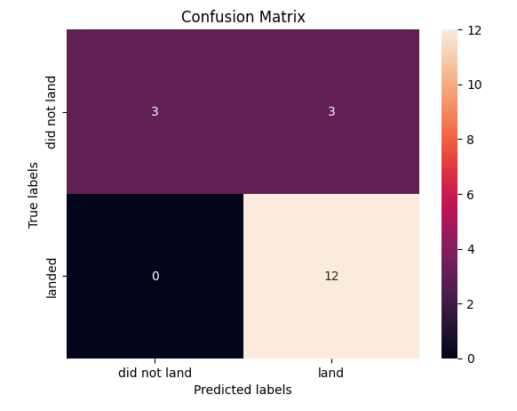
Confusion Matrix
This confusion matrix depicts the Logistic Regression model, which was the best model out of all the options in the lab.
https://github.com/RohitCodes22/Capstone-Repository-Final

Slide 39


